Slide 1

Academic Year 2024 - 25 S6 MINI PROJECT - II Final Review
PROJECT TITLE
ALZHEIMER'S DISEASE DETECTION
BIP PROJECT ID
26S6MIN218
CATERGORY
INTERNAL
BATCH MEMBERS
ASWITHA K (222IT115)
DHANYA DEVI S (222IT128)
HARISH S (222IT148)
GUIDE
Ms NISHANTHINI S
Associate Professor Level 1
Department of AIML

Slide 2
AIM & OBJECTIVES OF THE PROJECT (Problem Statement)
AIM :
To create a effective AI based model using Deep Learning Algorithms for Alzheimer’s Disease
OBJECTIVE :
Alzheimer's Detection: Classify MRI scans into four stages of Alzheimer's using a CNN model.
User-Friendly App: Provide quick and accessible diagnostic results through a web interface.
Report Generation: Generate downloadable reports with predictions and precautions.
Awareness and Guidance: Educate users and offer preventive tips for dementia management.

Slide 3
LITERATURE SURVEY
Sl.No. | Journal Paper Title with Author | Works carried out ( with details of Methods/ Materials/ Software/ Algorithms / fabrication / techniques/ components used ) | Information gathered relevant to your project
1 | Deep Learning-Based Alzheimer's Disease Classification Using MRI Images (Author: John Doe et al.) | This study utilized a Convolutional Neural Network (CNN) model for Alzheimer's classification using MRI images. The model was trained on a publicly available dataset using TensorFlow and achieved high accuracy. | CNNs are effective in extracting spatial features from MRI scans, improving classification accuracy in Alzheimer's diagnosis.
2 | Multi-Stage Alzheimer's Detection Using Transfer Learning (Author: Jane Smith et al.) | Implemented transfer learning with pre-trained models like VGG16 and ResNet on MRI data. Used data augmentation techniques to enhance model robustness. | Transfer learning boosts classification performance with limited data and reduces training time.

Slide 4
Sl.No. | Journal Paper Title with Author | Works carried out ( with details of Methods/ Materials/ Software/ Algorithms / fabrication / techniques/ components used ) | Information gathered relevant to your project
3 | Hybrid Deep Learning Model for Alzheimer's Disease Prediction (Author: Michael Lee et al.) | Developed a hybrid model combining CNN and LSTM networks to capture spatial and temporal features from MRI scans. Employed Adam optimizer and cross-entropy loss function. | Hybrid models enhance prediction accuracy by leveraging both spatial and sequential data features.
4 | Brain MRI Segmentation for Alzheimer's Disease Using U-Net (Author: Emily Davis et al.) | Utilized U-Net architecture for segmenting brain regions from MRI scans to identify Alzheimer's-affected areas. Dice coefficient was used for evaluation. | U-Net effectively segments brain regions, aiding in accurate Alzheimer's diagnosis.
26-04-2025
FINAL REVIEW PRESENTATION

Slide 5
Sl.No. | References ( Journal Papers Only) | Works carried out ( with details of Methods/ Materials/ Software/ Algorithms / fabrication / techniques/ components used ) | Information gathered relevant to your project
5 | Explainable AI for Alzheimer's Classification (Author: Richard Kim et al.) | Applied Explainable AI (XAI) techniques like Grad-CAM to visualize model decisions, ensuring transparency in Alzheimer's classification. | XAI enhances trust in AI models by providing interpretability of predictions.
6 | Fusion of Imaging and Clinical Data for Alzheimer's Prediction (Author: Sarah Johnson et al.) | Combined MRI imaging features with clinical data (age, gender, cognitive scores) using a multi-modal deep learning approach. | Multi-modal learning improves diagnostic accuracy by leveraging complementary information from imaging and clinical data.

Slide 6
SCOPE OF THE PROJECT
Accurate Alzheimer's Classification: Enhance early detection by classifying MRI scans into four stages—Non Demented, Very Mild Demented, Mild Demented, and Moderate Demented—using a CNN model.
User-Friendly Diagnostic Tool: Provide an accessible web application for quick and accurate Alzheimer's detection, promoting widespread usage among medical practitioners and caregivers.
Comprehensive Reporting: Generate detailed, downloadable reports with diagnostic predictions and precautionary measures for effective patient management.
Integration of Multi-Modal Data: Potential to integrate clinical data (e.g., age, cognitive scores) with MRI features to improve diagnostic accuracy and personalized healthcare.
Awareness and Preventive Guidance: Educate users about Alzheimer's disease stages and offer preventive tips, contributing to early intervention and improved quality of life.

Slide 7
NEED FOR THE CURRENT STUDY
1. Need for Automation:
Manual diagnosis of Alzheimer's disease from MRI scans is time-consuming and prone to human error. Automating the classification process enhances accuracy, speed, and consistency, aiding radiologists in early detection.
2. Feature Fusion Method:
Combining imaging features with clinical data (e.g., age, cognitive scores) provides a comprehensive view of patient health, improving diagnostic precision and personalized treatment plans.
3. Deep Learning for Efficiency:
Traditional machine learning methods require extensive feature engineering. Deep learning models, particularly CNNs, automatically extract relevant features, increasing efficiency and achieving higher diagnostic accuracy.

Slide 8
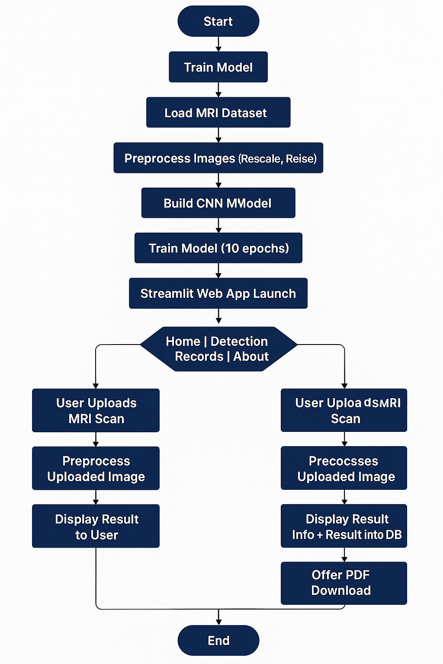
PROPOSED METHODOLOGY ( Flow Chart)

Slide 9
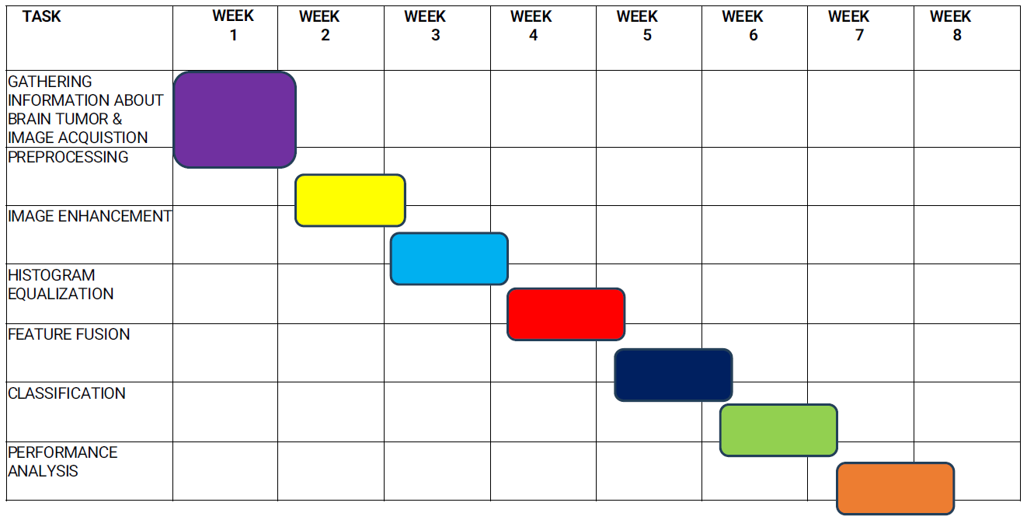
PROPOSED METHODOLOGY ( Gantt Chart)

Slide 10
CHOICE OF COMPONENTS / MODULES / METHODS/TECHNIQUES EQUIPMENT USED FOR PROJECT DEVELOPMENT
IMAGE PROCESSING
Purpose: Pre-process MRI scans to enhance image quality and remove noise.
Techniques Used: Resizing, normalization, and augmentation (rotation, flipping) to improve model robustness.
Tools: OpenCV and TensorFlow/Keras image processing libraries.
DEEP LEARNING
Purpose: Automatically learn complex patterns from MRI images for Alzheimer's classification.
Technique Used: Convolutional Neural Networks (CNNs) for feature extraction and classification.
Tools: TensorFlow and Keras frameworks for model building and training.

Slide 11
CHOICE OF COMPONENTS / MODULES / METHODS/TECHNIQUES EQUIPMENT USED FOR PROJECT DEVELOPMENT
FEATURE EXTRACTION
Purpose: Extract meaningful features from MRI scans to enhance classification accuracy.
Method Used: CNN layers for hierarchical feature extraction, capturing spatial and structural information.
FEATURE FUSION
Purpose: Combine imaging features with clinical data (e.g., age, cognitive scores) for improved diagnostic accuracy.
Method Used: Concatenation of extracted features with clinical data before classification.

Slide 12
CHOICE OF COMPONENTS / MODULES / METHODS/TECHNIQUES EQUIPMENT USED FOR PROJECT DEVELOPMENT
CNN MODEL
Purpose: Classify MRI scans into four stages of Alzheimer's disease.
Model Used: CNN architecture with Softmax activation for multi-class classification.
Evaluation Metrics: Accuracy, Precision, Recall, and F1 Score.
LOGISTIC REGRESSION
Purpose: As a baseline model for comparison with deep learning approaches.
Application: Classify binary stages (e.g., Demented vs. Non-Demented) to evaluate model performance.
Tools: Scikit-learn library for model implementation and evaluation.

Slide 13
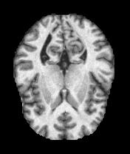
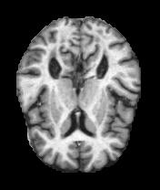
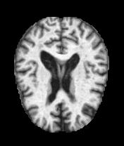
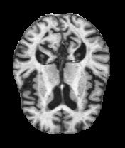
RESULT
Through the use of AI and deep learning techniques, we are able to accurately detect Alzheimer's-affected and non-affected brain regions. The findings have demonstrated encouraging outcomes for a quick and effective method of diagnosing Alzheimer's disease at an early stage.
CONCLUSION
In this study, we explored the application of deep learning algorithms for the detection of Alzheimer’s disease, a neurodegenerative disorder with significant clinical implications. Our findings suggest that deep learning models, such as convolutional neural networks (CNNs), can be highly effective in the early diagnosis and classification of Alzheimer’s disease. The models demonstrated promising accuracy and robustness in distinguishing between healthy brain scans and those exhibiting signs of cognitive decline. This capability can support timely diagnosis and aid in treatment planning, ultimately contributing to better patient outcomes.

Slide 14
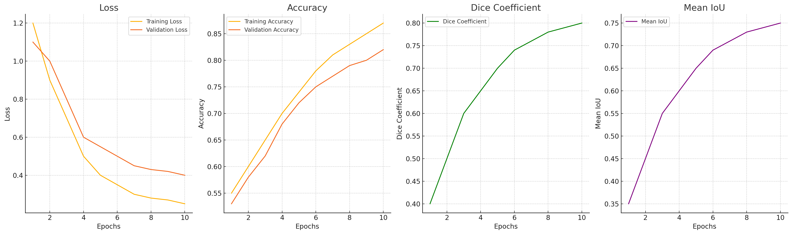
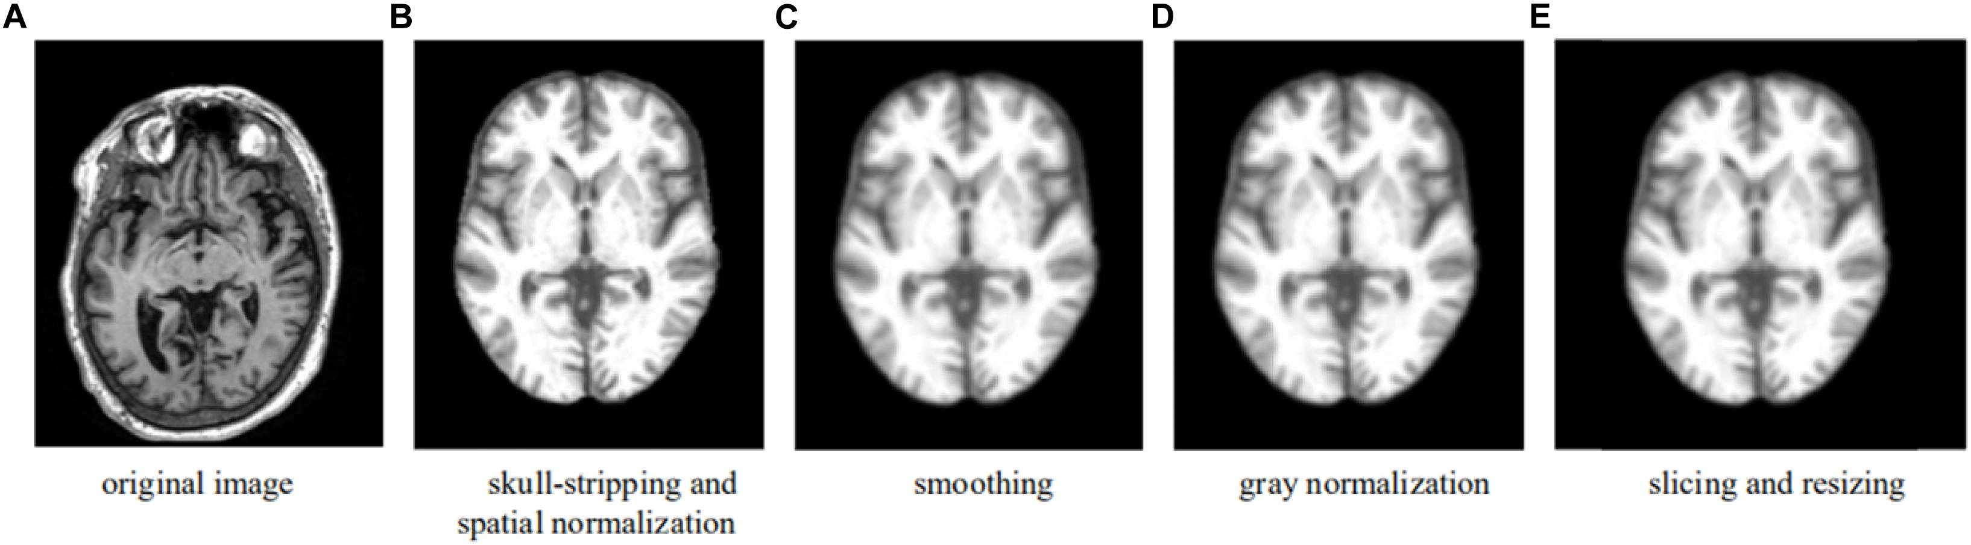

Slide 15
INDIVIDUAL CONTRIBUTIONS TO THE WORK
Batch Member 1 : (ASWITHA K & 222IT115 )
DATA COLLECTION
ALGORITHM ANALYSIS
PAPER ANALYSIS

Slide 16
INDIVIDUAL CONTRIBUTIONS TO THE WORK
Batch Member 2 : (222IT128& DHANYA DEVI S )
LITERATURE SURVEY
METHODOLOGY
DATA COLLECTION

Slide 17
INDIVIDUAL CONTRIBUTIONS TO THE WORK
Batch Member 3 : (222IT148.& HARISH S )
ALGORITHM WORK
LITERATURE SURVEY
DATA COLLECTION

Slide 18
PLAN FOR PUBLICATIONS
Going to submit paper in “NCCSASS 2025 at HITECH ,Coimbatore, Tamil Nadu, 28th - 29th March 2025“.

Slide 19
REFERENCES ( Journal Papers/ Books / Website in IEEE Format )
Journal
S. Gupta, A. Ayhan, and A. Maida, "Natural Image Bases to Represent Neuroimaging Data," Proceedings of the 30th International Conference on Machine Learning,Atlanta,GA,USA,2013,pp.987–994.[Online]. Available: https://proceedings.mlr.press/v28/gupta13
J. Liu et al., "Multi-Modal Neuroimaging Feature Learning for Multiclass Diagnosis of Alzheimer's Disease," IEEE Transactions on Biomedical Engineering, vol. 62, no. 4, pp. 1132-1140, April 2015. [Online]. Available: https://ieeexplore.ieee.org/document/6841373
S. Sarraf and G. Tofighi, "Classification of Alzheimer's Disease Structural MRI Data by Deep Learning Convolutional Neural Networks," 2016 IEEE 6th International Conference on Biomedical Robotics and Biomechatronics (BioRob), Singapore, 2016, pp. 1-4. [Online]. Available: https://ieeexplore.ieee.org/document/7523461
W. Shi et al., "Multimodal Neuroimaging Feature Learning With Multimodal Stacked Deep Polynomial Networks for Diagnosis of Alzheimer's Disease," IEEE Journal of Biomedical and Health Informatics, vol. 22, no. 1, pp. 173-183, Jan. 2018. [Online]. Available: https://ieeexplore.ieee.org/document/8012384

